Slide 1





React Methods: An Introduction
React methods are functions that allow you to interact with components, manage data, and handle user interactions. This module will explore how to use React methods effectively.
by Mir Junaid Rasool

Slide 2
Methods as Props
Passing Functions
Callback Functions
Methods can be passed as props to child components, allowing for communication and data sharing. This enables dynamic behavior and enhances component reusability.
Methods often serve as callbacks, triggered by events within child components. These callbacks allow parent components to respond to actions initiated by child components.

Slide 3

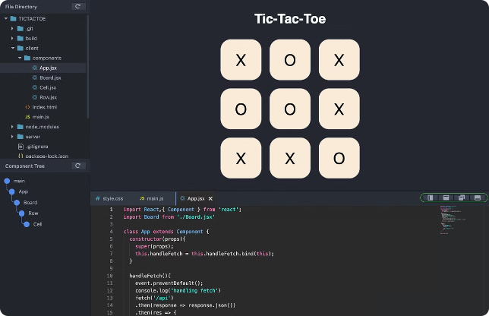
Prop Types
1
Validation
Prop types provide a way to validate the data being passed to components. This helps prevent errors and ensures data consistency.
2
Documentation
Prop types serve as clear documentation, informing developers about the expected data structure and types. This enhances code readability and maintainability.
3
Debugging
Prop type validation can help identify potential issues during development, making it easier to debug errors and improve code quality.

Slide 4

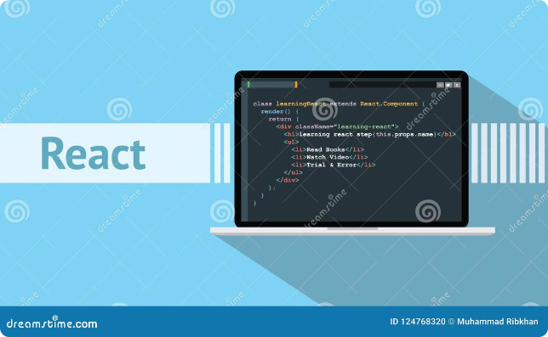
Props - Set 1
Basic Props
Simple data like strings, numbers, booleans, and arrays can be passed as props, providing dynamic values to components.
Object Props
Complex data structures like objects can be passed as props, enabling the transfer of multiple related values. This allows components to access and use data in a structured way.
Function Props
Methods can be passed as props, allowing for communication and interaction between parent and child components.

Slide 5

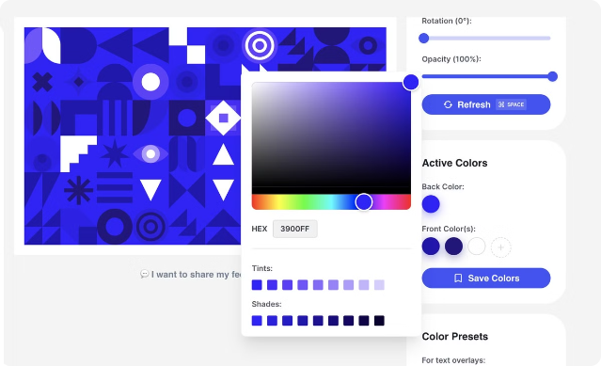
Props - Set 2
Prop Type
Description
String
Text values
Number
Numerical values
Boolean
True or false values
Array
Collections of values
Object
Data structures containing key-value pairs
Function
Reusable code blocks

Slide 6


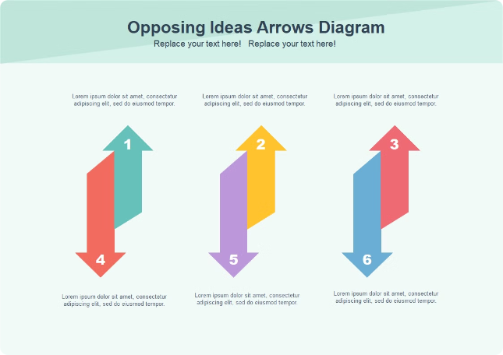


Unidirectional Data Flow
Data Flow
Data flows in one direction, from parent to child components. This creates a predictable and maintainable architecture.
State Updates
Parent components manage state. Child components receive updates through props, triggered by state changes in the parent.
Controlled Components
Unidirectional data flow ensures that UI elements are controlled by the parent component, preventing inconsistent data.

Slide 7





Handling User Interactions
Event Handling
React provides built-in mechanisms for handling user events like clicks, mouse movements, and keyboard input. These events can trigger methods and modify component state.
Forms
Methods are used to process form data, validate inputs, and submit information. This enables user interaction and data management.
State Updates
User interactions can trigger state updates, leading to changes in the UI and data flow within the application. This creates a responsive user experience.

Slide 8

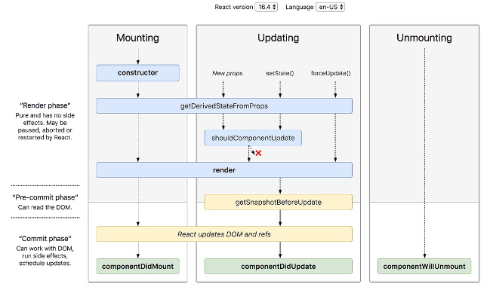
Lifecycle Methods
1
Mounting
Methods triggered when a component is first rendered and added to the DOM. This allows for initialization and setup.
2
Updating
Methods triggered when a component's state or props change. This allows for updating the UI or performing actions based on new data.
3
Unmounting
Methods triggered when a component is removed from the DOM. This allows for cleanup tasks and resource management.

Slide 9


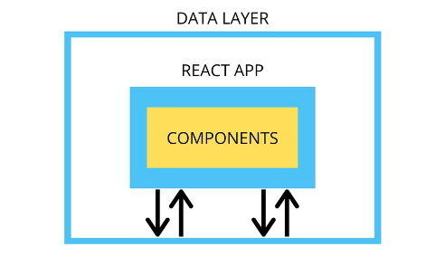
State Management
useState Hook
useReducer Hook
Context API
The useState hook allows components to manage their own local state. This enables independent state management within components.
The useReducer hook provides a more structured way to manage state, especially when dealing with complex state transitions.
The Context API allows sharing state across multiple components, simplifying state management in complex applications.

Slide 10


Best Practices for React Methods
1
Functional Components
Methods should be defined as functions within functional components. This promotes reusability and readability.
2
Data Immutability
Methods should not directly modify state. Instead, they should create new copies of state, ensuring data consistency.
3
Clear Naming
Methods should be named descriptively, reflecting their purpose. This improves code clarity and maintainability.
4
Separation of Concerns
Methods should be focused on specific tasks, adhering to the principle of separation of concerns. This promotes modularity and organization.

